Slide 1

Applying Machine Learning to Chatbot Content Detection
Aaron Weiss – MS Applied Statistics

Slide 2



Slide 3
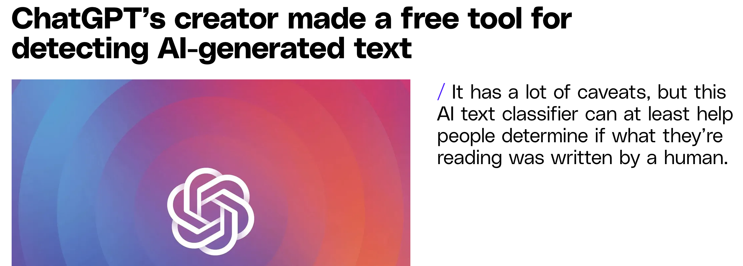


Slide 4
History
LLM – Large Language Model
“Attention is All You Need” from Google
ChatGPT from OpenAI
Model became publicly available and gained widespread usage overnight

Slide 5
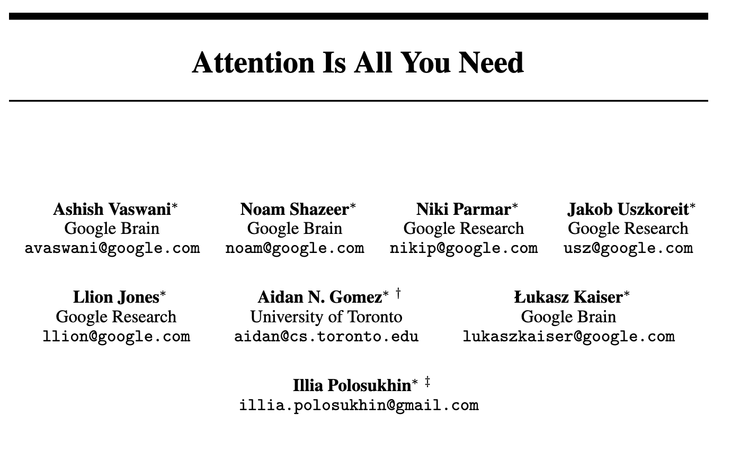

Slide 6
The Problem
ChatGPT is pretty darn good at writing
Trained on human written text, so that’s what it writes
Current methods are inconsistent
Code, non-English languages, and intentional errors

Slide 7
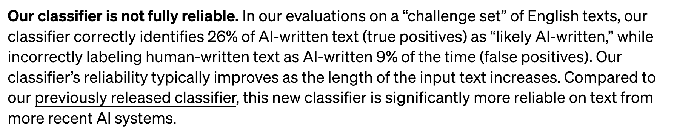
The Problem, as stated by OpenAI
Notes:
Clarify who wrote this paragraph (probably not us! Possibly an AI ☺ ? )

Slide 8
Methodology
Generate content using OpenAI’s API & GPT 3.5 Turbo
Based on human-written articles from medium.com
as presented as a dataset at Kaggle
Create classifier models using the OpenAI Fine Tuning API
Analyze results

Slide 9
What does AI text look like?
6Th Grade
Civic humanism is a philosophy that emphasizes the importance of civic participation and moral excellence in society. Humanists believed that people could become better citizens through education, and that active participation in government and community affairs was essential for individual and societal wellbeing. There are many important lessons that can be learned from civic humanism, and these lessons are still relevant today.
One of the most important lessons of civic humanism is the importance of education. Humanists believed that education was the key to individual and societal improvement, and that everyone should have access to education. In the Renaissance, humanists emphasized the study of classical literature and languages, as well as science and mathematics, because they believed that these subjects would help people understand the world and become better citizens.
College
Civic humanism is a philosophy that emphasizes the active participation of individuals in their communities and the common good. This philosophy is based on the belief that individuals have a responsibility to serve their communities and promote the common good. Civic humanism is a concept that has been in existence for centuries, and it has had a profound impact on society.
There are several important lessons to be learned from civic humanism, which can help individuals become more engaged and active members of their communities. These lessons include the importance of civic engagement, the value of public service, and the need for ethical leadership.

Slide 10
Experiment 1
Getting ChatGPT to create content in the style of human writers in
6th grade
10th grade
College
Train a classification model using that dataset
Analyze results

Slide 11


Results: AI - 6th Grade vs. 10th vs College
Accuracy
Loss
Training Iterations
Training Iterations

Slide 12
Results: Experiment 1 example
prompt | completion | prediction
Thanksgiving is the day when families get together to feast and share stories. This year, due to the pandemic, many families are meeting online via Zoom. Since we cannot meet in person, let's imagine what our relatives would be like if they were characters in Jane Austen's novels. Firstly, my aunt would be like Mrs. Bennet from Pride and Prejudice… | 6thgrade | 6

Slide 13
Experiment 2:
Comparing all generated data to the original source

Slide 14


Results: AI vs. Human Writing
Accuracy
Loss
Training Iterations
Training Iterations

Slide 15
Results: Experiment 2
100% Accuracy? Problem solved!
Unfortunately, probably not.
Small sample size
Constrained input variety
Limits in cost/time
Model opacity
Short texts

Slide 16
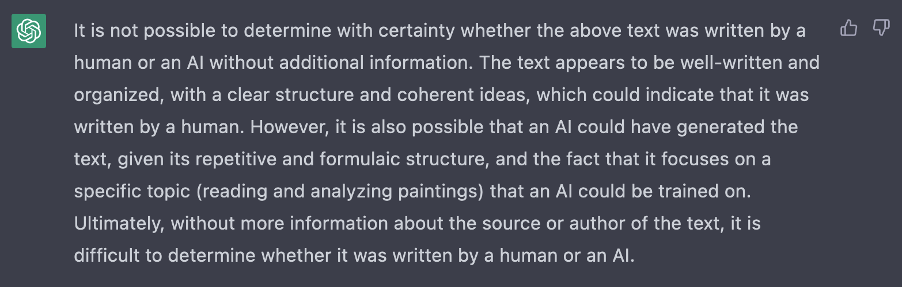
What Does ChatGPT Think?
ChatGPT, do you think this writing is human or AI, and why?

Slide 17
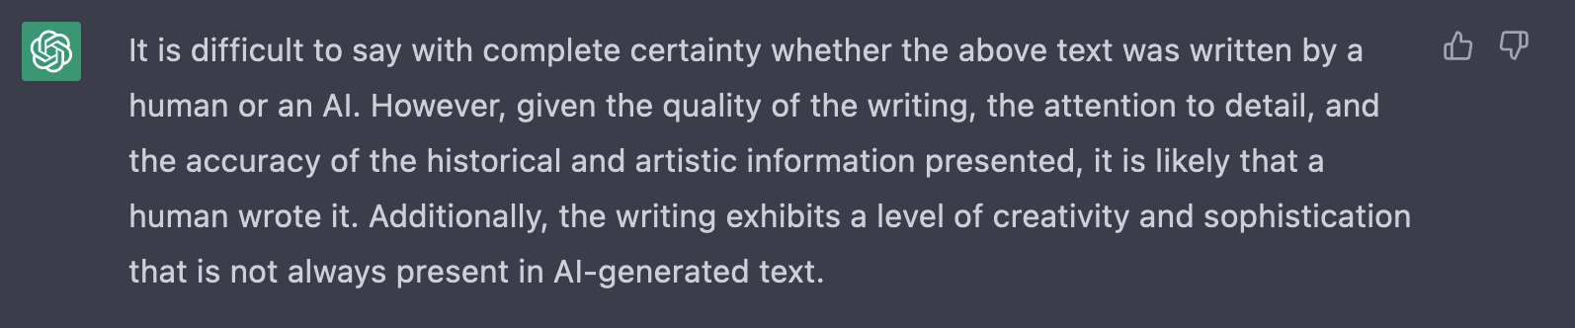
What Does ChatGPT Think?
ChatGPT, do you think this writing is human or AI, and why?

Slide 18
Future work
Generate more data
Gather a more diverse data set
Create different models that can take more parameters
Explore prompt methods for creation and classification

Slide 19
Thank you!
Special thanks to Dr. Andrew Ross, faculty mentor on this project
Q&A?

